Slide 1




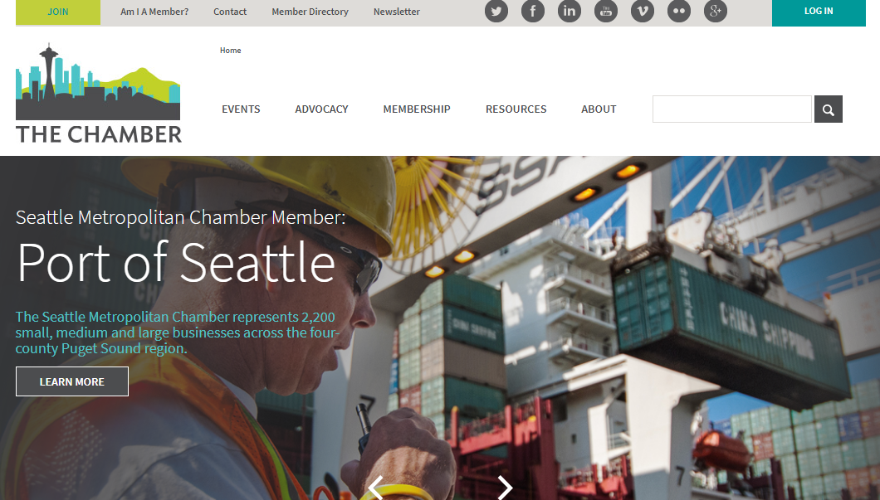
Seattle Chamber of Commerce
Who They Are The Seattle Metropolitan Chamber of Commerce was founded by local business leaders in 1882 to advocate for a vital business environment.
Business Need When someone becomes a member of the Seattle Chamber, they get access to their own Member Dashboard, a personal portal for members to update their information and find several useful resources such as savings tools and events, which is the Chambers main source of revenue.
However, they found that members were under-utilizing the resources provided through the dashboard. The Chamber wanted to fix this problem with an updated portal that was easier to navigate, had a better design, and provided an overall refresh to remind members of all the resources they have access to and to increase their event registrations.
Results
https://www.seattlechamber.com/
Affirma delivered an updated member dashboard for Seattle Chamber of Commerce that not only looks good, but more importantly is member focused. The new portal is simple, allowing members to find exactly what they need. The member profile settings are clearly labeled, in the center of the page, and the links to the most popular sources are located on the right side and are clearly labeled. This updated design provided a more engaging experience for their members. It made it easier for people to register for their events and utilize the other advantageous tools that the Chamber makes available to them. We were pleased that the work was done on schedule and under budget, which allowed the Chamber to add some additional unscheduled changes without any issue.

